Slide 1
PIC 50058 Fatal Errors
Presented By:
Charlie House
Program Analyst, HUD Omaha Office
September 14, 2023

Slide 2
Importance of Correcting PIC Errors
Submission errors occur when Housing Authorities submit incompatible or incomplete HUD Form 50058 files to PIC. In accordance with PIH Notice 2011-65, 50058s and any related corrections must be submitted within 60 calendar days from the effective date of any action
It is important to timely identify and correct PIC errors to:
Prevent having to back track to fix problems
Gain an understanding of why errors occur and prevent them in the future
Prevent one error from causing multiple problems in other areas
HUD uses the information submitted in PIC on the 50058 to:
Monitor PHA performance for both the Public Housing (PH) and HCV Programs
Analyze the program and determine future funding levels
Prevent tenant fraud and duplication of benefits
To provide data to Congress and other interest groups

Slide 3
Identifying PIC Errors
It is best practice to assure that each submission was accepted by PIC successfully with no errors by checking the submission receipt and clicking the Report tab.

Slide 4
Identifying PIC Errors
Do not assume each 50058 you submit into PIC is accepted just because FRS or a third-party software did not have any errors when you created your file to submit into PIC.
The software only knows what you’ve input into the software previously. It does not know if a household has been flagged in the PIC Invalid Tenant ID Report, Possible Duplicate Report, etc. that could cause a fatal error upon submission.

Slide 5
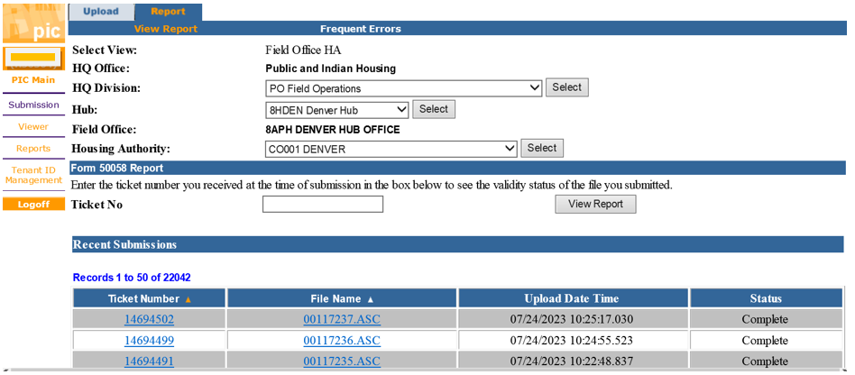
Identifying PIC Errors
Submissions with PIC Errors can be identified by reviewing the 50058 Error Report in the Submissions submodule of PIC and taking the following steps:
Go to the Submission submodule
Select the PHA from the dropdown menu
Click the Report Tab (not the Report submodule) to see a list of ticket numbers for files submitted to PIC
Click on the ticket number to access the ticket report page
Choose HTML to open the report
The report will open in a pop-up box

Slide 6
Identifying PIC Errors
If a submission error has occurred, the “Submission Error Report Format” links will appear in red.

Slide 7
Identifying PIC Errors
Utilizing the first “HTML” link to review the Entire Error report, will reveal:
the number of 50058’s submitted,
the number accepted and rejected,
the number of submissions containing warnings or fatal warnings,
the personal identifiable information of the form
And the number of errors as well as the error message that clearly indicates the discrepancy.

Slide 8
Common PIC Fatal Errors

Slide 9
Common PIC Fatal Errors
Error 4181: This tenant already exists at this PHA in the IMS-PIC database. New admission cannot be accepted.
This error occurs when a 50058 is entered into PIC with an action type New Admission (2a action type 1) and the SSN of the tenant already exists in PIC.
Correction Methods: First, verify the action type submitted was the correct action type. If the action type submitted was incorrect, submit the 50058 with the correct action type. If the action type was correct, verify the SSN is accurate. Then verify the current 50058 in the Viewer submodule is correct. If the 50058 already exist, the submission could have been a duplicate submission and therefore can be ignored.

Slide 10
Common PIC Fatal Errors
Error 4174: This is a new tenant in IMS-PIC. No 50058 data for this head of household exists.
This error occurs when a 50058 is entered into PIC with an action type other than a New Admission (2a action type 1) and Portability Move-in (2a action type 4) and the for a tenant with an SSN that is not currently in PIC.
Correction Methods: First, verify the SSN number for accuracy. Then verify there is no current 50058 in the Viewer submodule searching by their name. If the SSN is accurate and there is no current 50058, then submit a New Admission (2a=1) for the household.
DO NOT submit a Historical Adjustment (2a=14) without first verifying with the Field Office. This action type should rarely be used.

Slide 11
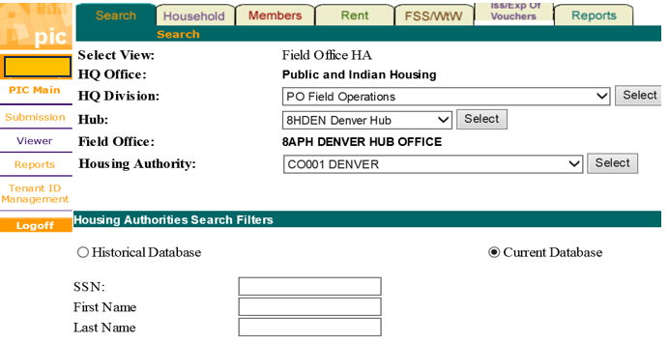
Common PIC Fatal Errors
Error 4080: A record with a later effective date exists in the database.
This occurs when a PHA tries to submit a 50058 with an effective date that is earlier than the last 50058 accepted by PIC. Typically, this occurs when a PHA submits a 50058 with future effective dates.
Correction Methods: Go to the Viewer module to pull up the 50058, check the effective date and current action type. Submit a 50058 with a later effective date than the one in the system. If the 50058 in the system is incorrect, submit a 50058 with a Void (2a=15) to delete the 50058, then submit a 50058 with the correct information.

Slide 12
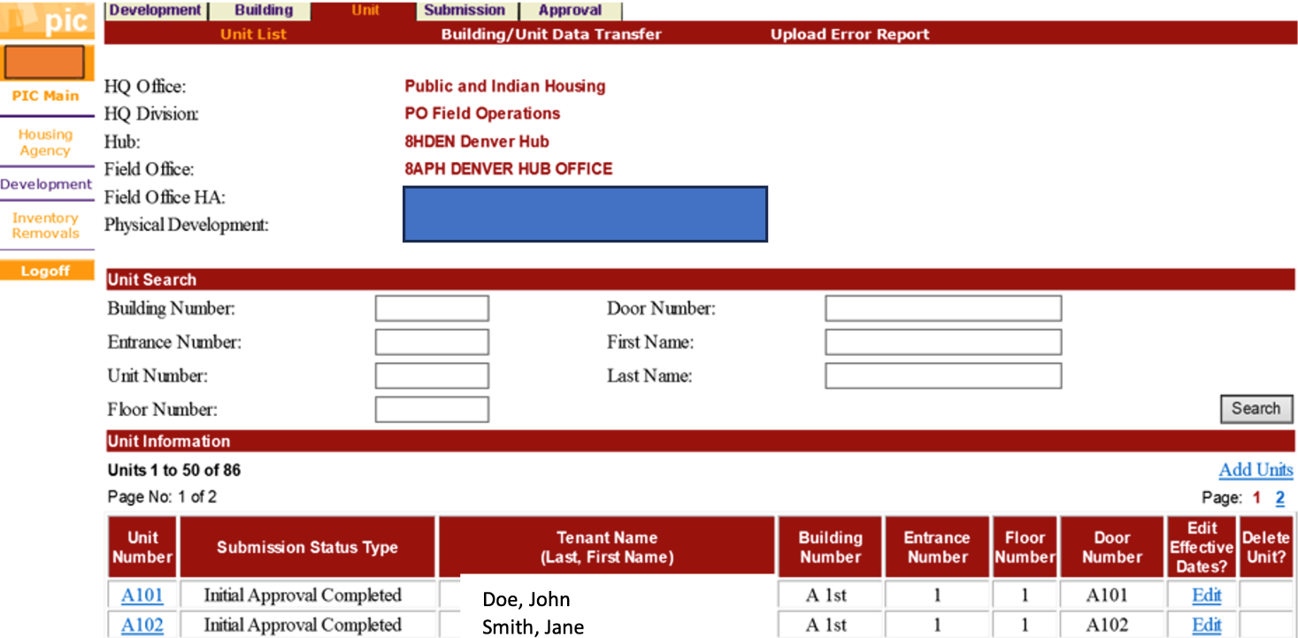
Common PIC Fatal Errors
Error 4048: Unit must be vacant in the case of New Admission, Historical Adjustment, or Other Change of Unit.
This error occurs when there is a tenant in the unit according to PIC.
Correction Methods: Check the unit detail in the development submodule, check the name and SSN of the tenant in the unit (sometimes the name is correct, but the SSN is wrong) if this is not the tenant (or correct SSN), EOP (2a=6) the tenant. Move the new tenant (or tenant with the correct SSN) in. If the this is the tenant that should be there, no action is needed.

Slide 13
Common PIC Fatal Errors
Error 5332: The SSN/AID (Alternate ID) in this household appears in other households.
The SSN can belong to the HoH or a household member. The Field Contents section of the submission error report will help identify which SSN is being rejected.
Correction Methods: If a PHA erroneously has the member on a family’s record, review the Possible Duplicate Report in PIC. The PHA identified must remove the tenant by an EOP (2a=6), Port-out (2a=5) or by submitting a 50058 with without the SSN in question which will allow the correct PHA to submit the 50058 with the member in the household.

Slide 14
Researching The Error In PIC
The Viewer Submodule
Look up family by name or SSN
View or print the most recent (current) 50058
Historical: provides access to all prior 50058s accepted for the family
Development Submodule
Look up HoH name in the Unit tab for specific unit
HA Query Report – provides the following:
The PHA the family is being reported at
The specific housing program
The date and last type of action

Slide 15
Additional Resources
Youtube Video Shorts:
PIC Error Correction Training: PIC Error 5280 Voucher Record
PIC Error Correction Training: PIC Error Removal Form Video Short
PIC Error Correction Training: PIC Error 4006 PHA Code Video Short
PIC Error Correction Training: PIC Error 4080 Later Effective Date
PIC Error Correction Training: PIC Error 4174 New Tenant
PIC Error Correction Training: PIC Error 4182 Tenant Already Exists

Slide 16
Additional Resources
Correcting Building and Unit Data Anomalies | HUD.gov / U.S. Department of Housing and Urban Development (HUD)
Form 50058 Tenant ID Management FAQs - IMS/PIC | HUD.gov / U.S. Department of Housing and Urban Development (HUD)
Form 50058 Submission FAQs - IMS/PIC | HUD.gov / U.S. Department of Housing and Urban Development (HUD)

Slide 17
PIC Error Dashboard
The PIC Error dashboard is designed consolidate active PIC errors in one place. Updated weekly!
Link to PIC Error Dashboard Webpage. Includes the following resources:
The PIC Error Dashboard
The PIC vs VMS Leasing Data in Program dashboard
PIC Error Correction Guidebook for the HCV Program:
Job aids and training videos for common PIC errors
Notes:
OPEN AND VIEW THE DASHBOARDD - TOUR IT
OPEN AND VIEW THE WEBPAGE

Slide 18
Frequent Errors Report
Found Here!
Consider sharing this report during staff meetings:
Facilitate a discussion about why each error is likely to occur.
Ask for volunteers to research an error to describe the problem and resolution.
Download the report and save periodically in Excel to track changes over time.
Notes:
NEXT SLIDE

Slide 19
PIC Resources
Get Help webpage: IMS/PIC - Get Help - HUD | HUD.gov / U.S. Department of Housing and Urban Development (HUD)
Form 50058 Webpage: Form 50058 - HUD | HUD.gov / U.S. Department of Housing and Urban Development (HUD)
PIC User Manual: IMS/PIC User Manuals - PIH - HUD | HUD.gov / U.S. Department of Housing and Urban Development (HUD)
PIC Job Aids: Job Aids - IMS/PIC - HUD | HUD.gov / U.S. Department of Housing and Urban Development (HUD)
Notes:
NEXT SLIDE

