Slide 1
Financial Statements & Operating Fund
Presented by: Rick Schwartz, Loucks & Schwartz

Slide 2
Financial Statements & Operating Fund
Financial Statements
Form HUD-52723, Program Expense Level
Form HUD-52722, Utility Expense Level

Slide 3
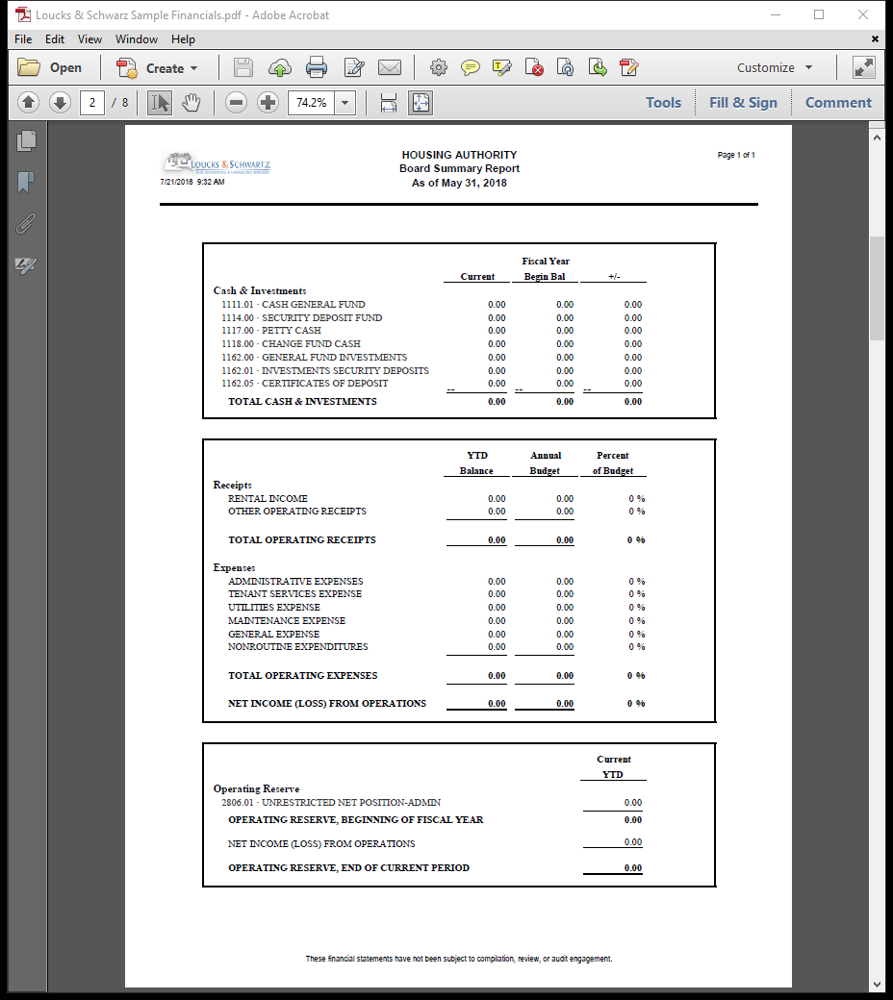
Board Summary Report
Key points:
Cash & investments increase or decrease from beginning of fiscal year.
Comparison of operating income & expense as percentage of annual budget.
Operating reserve balance as of month end. Balance is cumulative since formation of Housing Authority. Good point of reference is to have at least 3 to 6 months operating reserve.

Slide 4
Statement of Net Position
Key points:
Current assets generally consisting of cash, investments, receivables, and prepayments.
Fixed assets held by the PHA for future use. Capitalization dependent on Agency’s cap policy.
Liabilities generally consist of accounts payable, security deposits, payroll accrual, payroll withholding and accrual for payments in lieu of taxes.

Slide 5
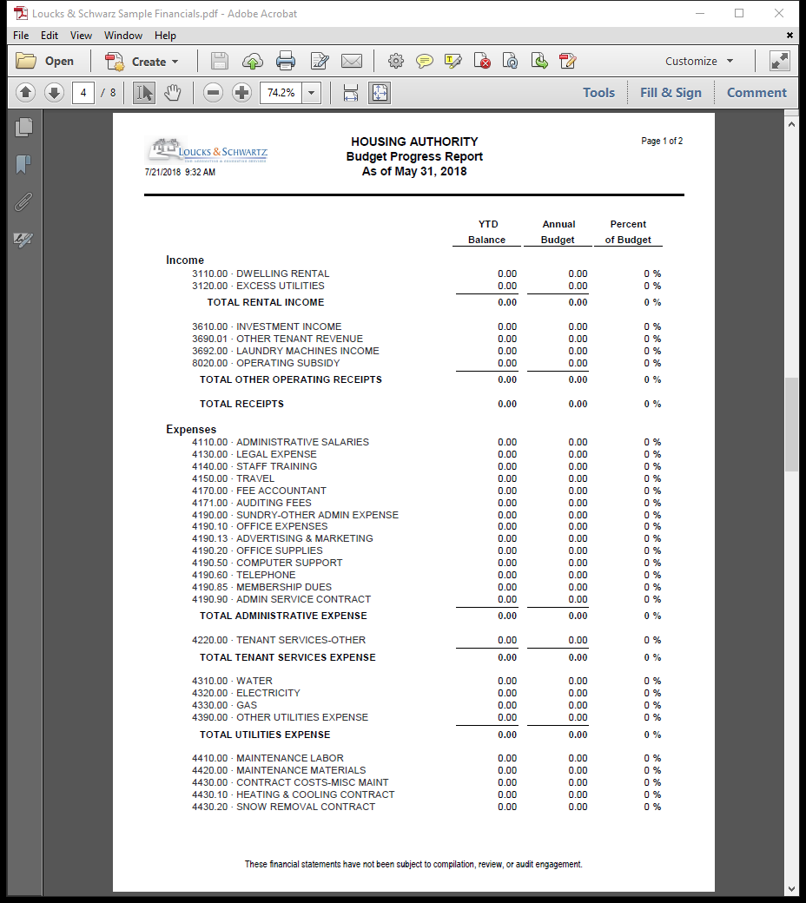
Budget Progress Report
Key points:
Comparison of year-to-date actual results with annual budget.
First glance for category subtotals as percent of annual budget spent.

Slide 6
Budget Progress Report (continued)
Key points:
Increase (decrease) in Unrestricted Net Position reflects either an addition to or subtraction from Operating Reserve.

Slide 7
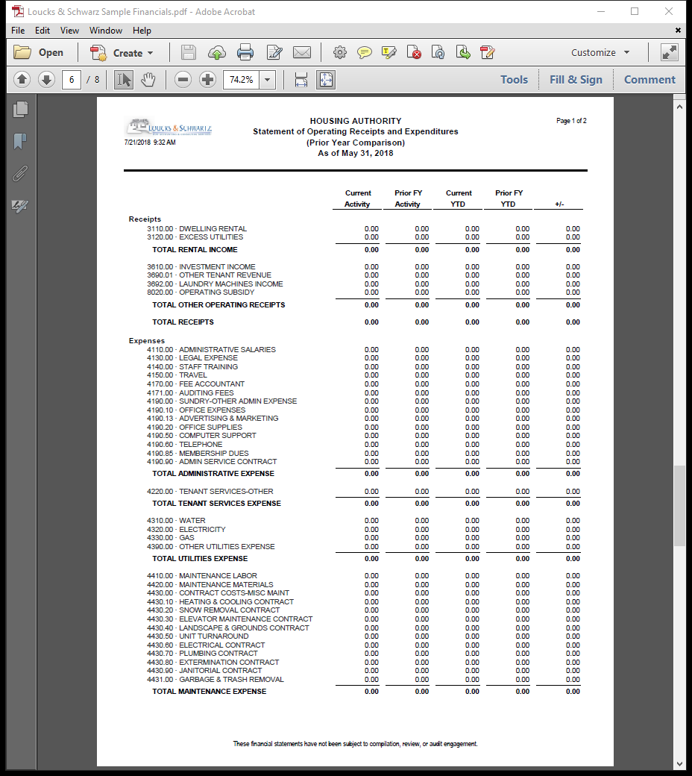
Statement of Operating Receipts & Expenditures
Key points:
Comparison of current month with same month in prior fiscal year.
Comparison of current month year-to-date with same period in prior fiscal year.
Last column showing increase/decrease in year-to-date total from prior fiscal year to current fiscal year.

Slide 8
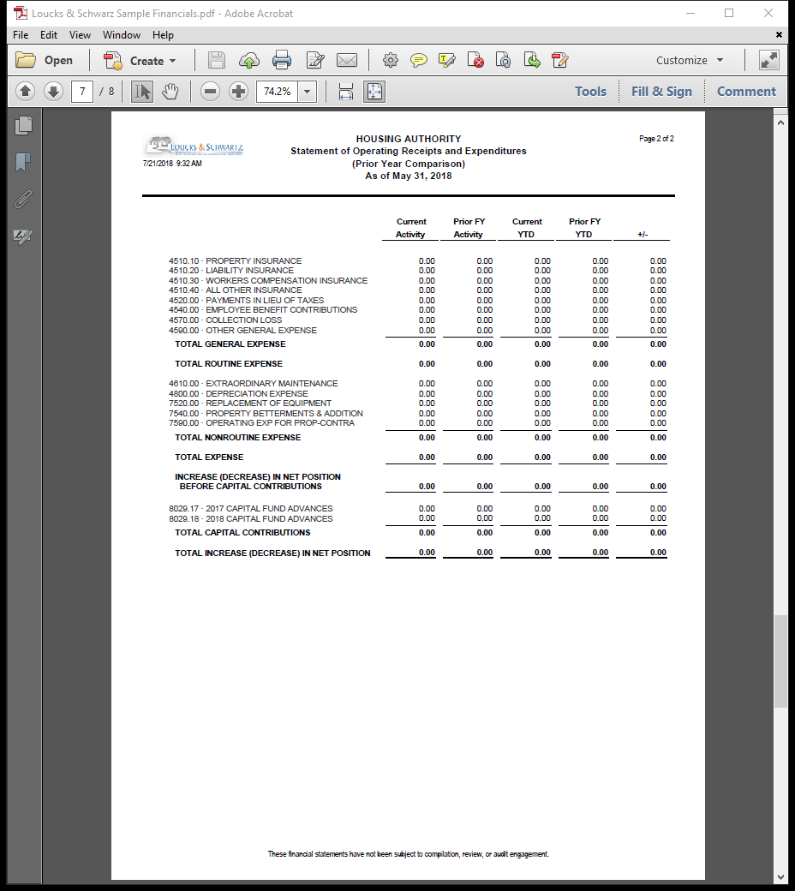
Statement of Operating Receipts & Expenditures (continued)
Key points:
(Increase) decrease in Net Position reflects total change in all categories of Net Position.

Slide 9
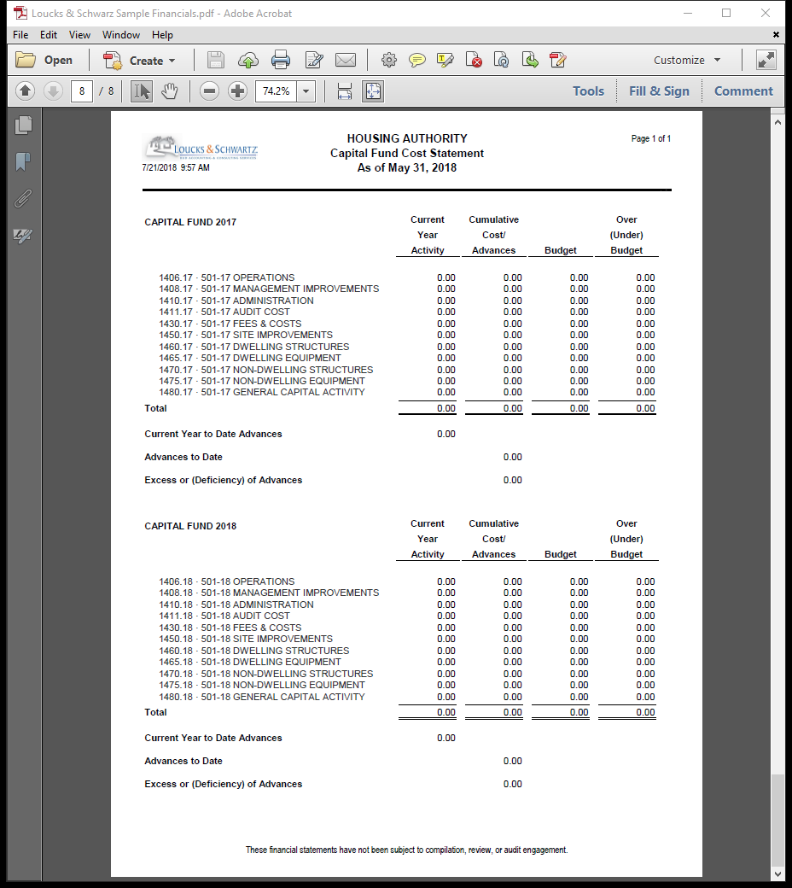
Capital Fund Cost Statement
Key points:
Capital Fund Program grant activity by grant year.
Activity by grant year for current fiscal year, cumulative cost and advances, grant budget amount by budget line item and amount spent over (under) budget.

Slide 10
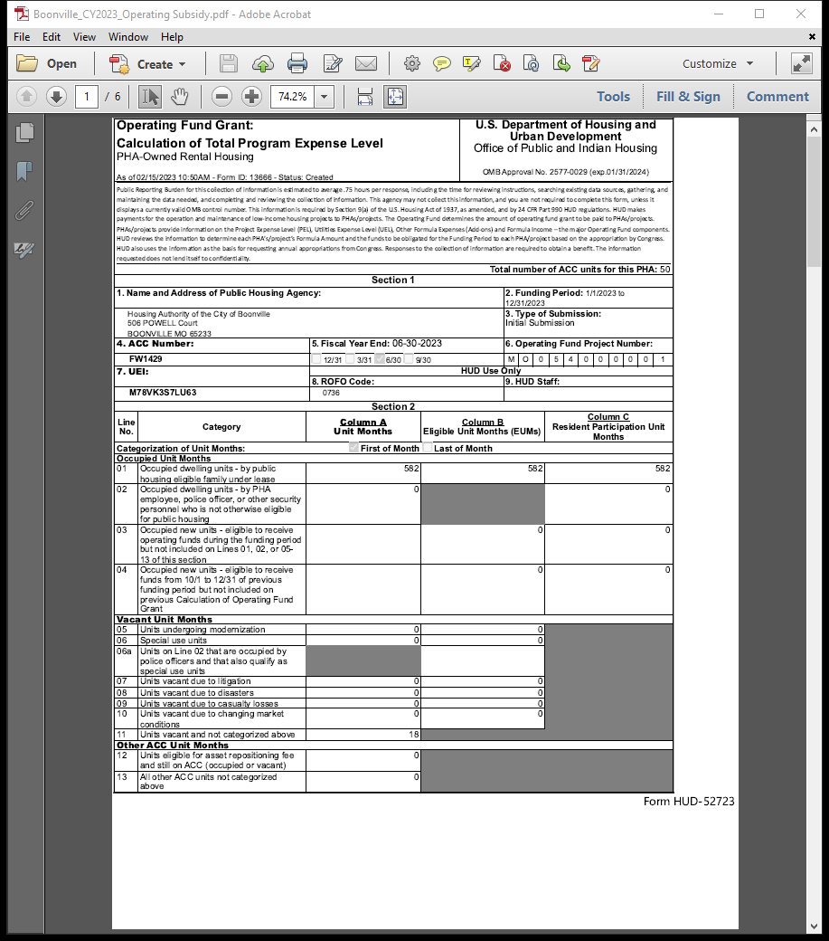
Operating Fund Grant Form HUD-52723
Key points:
Section 2 information prepopulated from 50058 data submitted in PIC.
Vacant unit status as maintained in PIC.
Line 13 generally reflects non-dwelling units or over-income units not eligible for receiving operating subsidy.

Slide 11
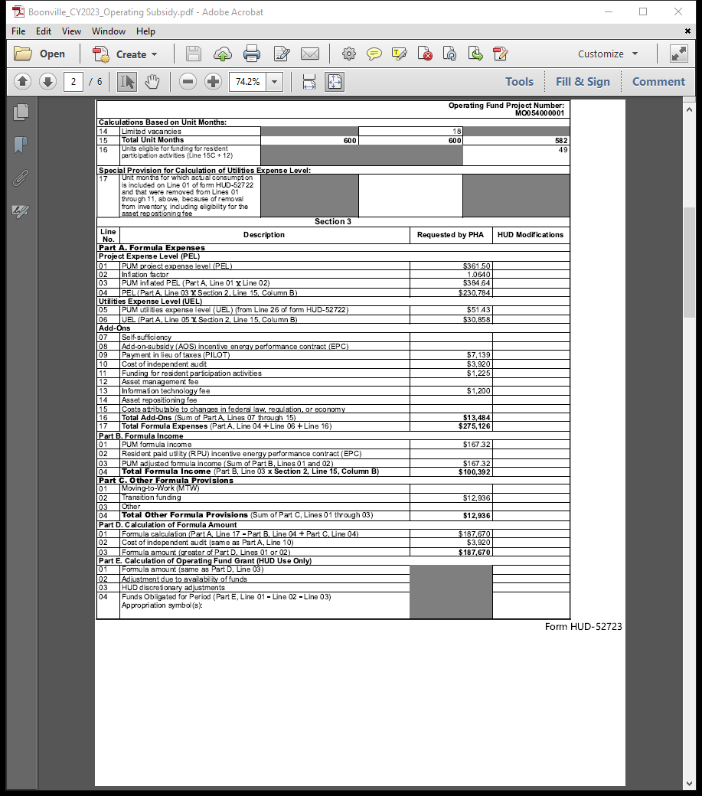
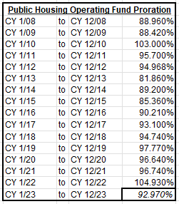
Operating Fund Grant Form HUD-52723 (cont’d)
Key points:
Section 3, Part A, line 02, inflation factor applied by HUD for grant year.
Part D, line 01, amount eligible for operating subsidy before proration.

Slide 12
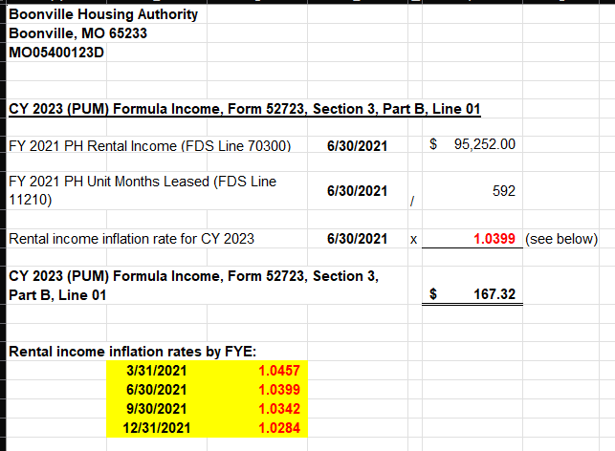
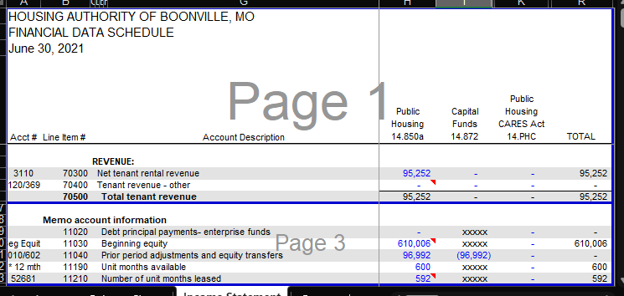
Operating Fund Grant PUM Formula Income
Key points:
Section 3, Part B, line 01, reflects average dwelling rental income by unit.
For CY 2023 Operating Subsidy, rental income and unit months leased utilized from fiscal years ending in 2021.

Slide 13
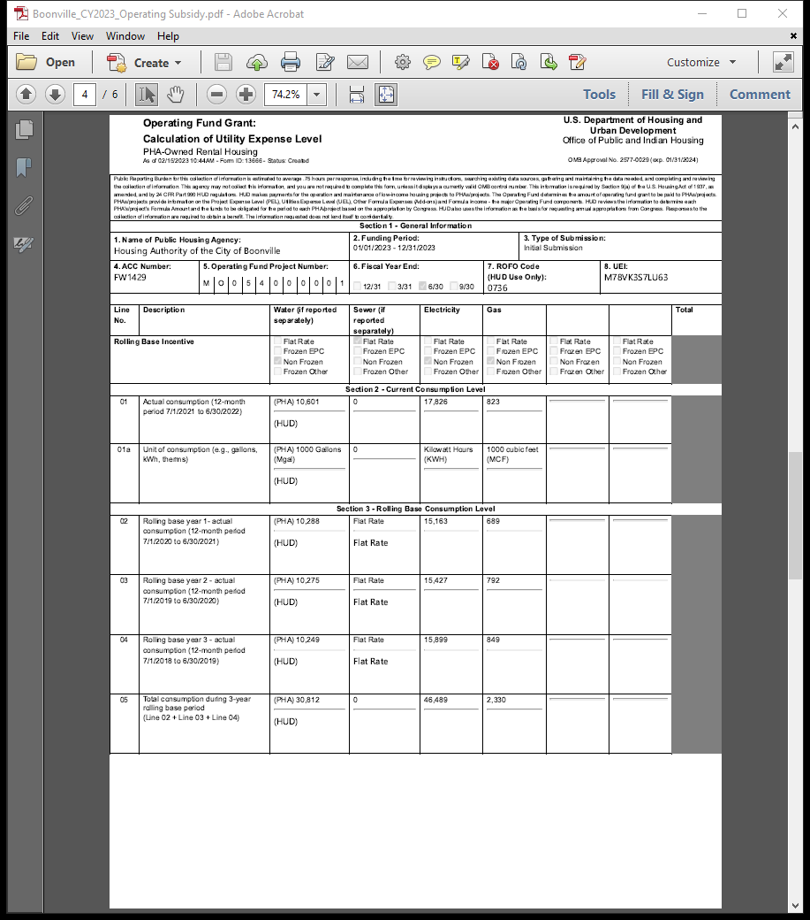
Operating Fund Grant Form HUD-52722
Key points:
Line 01, actual consumption for twelve-month period ending June 30th.
Line 01a, unit of consumption reported by utility type.
Lines 02-04, actual consumption reported for three year rolling base.

Slide 14
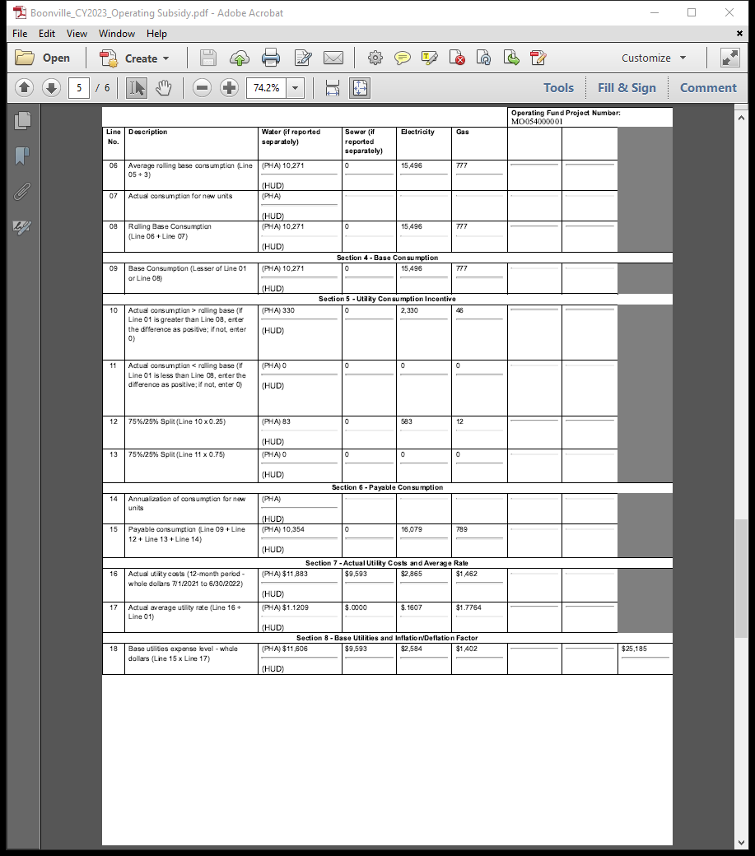
Operating Fund Grant Form HUD-52722 (cont’d)
Key points:
Line 16, actual utility costs by utility type.
Line 17, actual average utility rate by utility type.
Line 18, base utilities expense level calculated as payable consumption multiplied by actual average utility rate.

Slide 15
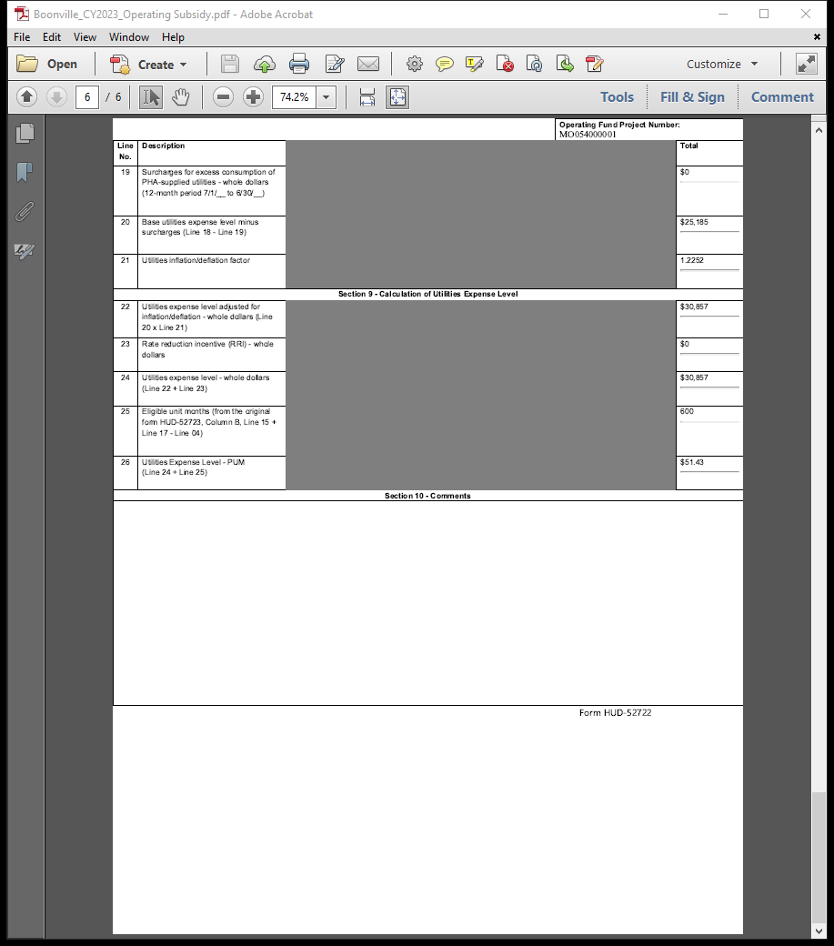
Operating Fund Grant Form HUD-52722 (cont’d)
Key points:
Line 21, utilities inflation/deflation factor.
Line 25, eligible unit months for number eligible for operating subsidy.
Line 26, calculated PUM utilities expense level.

Slide 16
Thank you!

