Slide 1
PHA 5-Year Plan Training
Nebraska Fall NAHRO
September 13, 2023
Omaha Field Office

Slide 2
PHA Plan Training Goals
Public Housing Agency (PHA) Plan Overview
Statutory/Regulatory Framework
PHA Plan Development Process & Submission Cycle
5-Year PHA Plan Requirements/Template Overview
Wrap up – Unique Situations, Knowledge Check, Resources and Miscellaneous
Questions

Slide 3
PHA Plan Overview

Slide 4
PHA Plan Overview
Comprehensive Guide
PHAs required to develop a guide detailing their mission and goals and how they plan to meet them through activities, programs and updates to their policies.
Community participation in decisions directly impacting PHA and HCV programs and transparency
Consultation
Resident Advisory Board (RAB), public, and other stakeholders
Types
Annual and 5-Year
PHA/HUD Roles
PHA completes the PHA Plans, submits to HUD for review/approval
Report
Local Accountability
Progress against prior 5 - Year Plan

Slide 5
Annual Plan vs 5-Year Plan
Annual Plan (Detailed) | 5-Year Plan (Big Picture)
The Annual PHA Plan provides details about The agency’s immediate operations, program participants, policies, and The agency's strategy for handling operational concerns, residents' concerns and needs, and Programs and services for the upcoming fiscal year. | The 5-year PHA Plan describes the mission of the agency and the agency’s long-range goals and objectives for achieving its mission over the subsequent 5 years.
Non-qualified PHAs submit Annual Plan | All agencies submit a 5-Year Plan

Slide 6
Annual Plan Elements (HUD-50075)
Housing Needs
Financial Resources
Tenant Eligibility, Selection, and Admissions Policies
Rent Determination Policies
PHA’s operation and Management
PHA Grievance Procedures
Statement of Capital Improvement Needed
Any Demolition and/or Disposition
Developments Designated as Housing for Elderly Families, Families with Disabilities, or Mixed
Conversion of public housing to tenant-based assistance
Homeownership Programs Administered by the PHA
PHA's Community Service and Self-Sufficiency Programs.
PHA's Safety and Crime Prevention Measures
PHA's Policies and Rules Regarding Ownership of Pets in Public Housing
Civil Rights Certification
Recent results of PHA's fiscal year audit
A Statement of Asset Management
Components
24 CFR § 903.7

Slide 7
5 Year Plan Elements (50077-5Y)
A. PHA Information
Components
B. Plan Elements
1. Significant Amendment or Modification
2. Resident Advisory Board (RAB) Comments
3. Certification by State or Local Officials
1. Mission
2. Goals and Objectives
3. Progress Report
4. Violence Against Women (VAWA) Goals
C. Other Document and/or Certification Requirements
D. Affirmatively Furthering Fair Housing (AFFH)
24 CFR § 903.6

Slide 8
PHA Plan Statutory/Regulatory Framework

Slide 9
Statutory & Regulatory Framework
1998 Quality Housing and Work Reform Act (QHWRA), Section 511
(See USC§1437c-1)
Capital Fund Program Tables as attachments to the Annual PHA Plan
5 Year PHA Plan
24 CFR §903.6
PHA Annual Plan
24 CFR §903.7
2008
Housing and Economic Recovery Act
(HERA), Section 2702
Separate Annual CFP Submission thru EPIC
(See Also:
78 FR 63747 (10/24/13))
Non-Qualified PHAs
Qualified PHAs
5 Year PHA Plan
Annual PHA Plan
5 Year PHA Plan
No longer required to prepare or submit the Annual PHA Plan, but must:
Conduct a Public Hearing
Submit a Civil Rights Certification
Omaha FO PHA PLAN TRAINING
9

Slide 10
Non-Qualified and Qualified PHAs
Qualified PHAs | Non-Qualified
≤550 Combined Public Housing Units and Housing Choice Vouchers | >550 Combined Public Housing Units and Housing Choice Vouchers
Not designated as “Troubled” under PHAS Does not have a failing SEMAP score during prior 12 months | Designated Troubled in PHAS or SEMAP
Exempt from Annual Plan Submission PHA Plan Qualified PHAs | HUD.gov / U.S. Department of Housing and Urban Development (HUD) | Must submit an Annual Plan* PHA Plan: Non-Qualified PHAs | HUD.gov / U.S. Department of Housing and Urban Development (HUD)
* Even though Qualified agencies are exempt from completing the Annual PHA Plan, they are still required to annually conduct a hearing to discuss any changes to the goals, objectives, and policies of the agency, and invite public comment. The Qualified Agencies are required to comply with the 45-day public comment period. (Section 2702 of HERA)

Slide 11
How do I know what my designation is?
The Qualified PHA list:
Updated here on a quarterly basis (3/31, 6/30, 9/30, 12/31)
These PHAs meet the criteria of a Qualified agency under HERA for the purpose of being exempt from the requirement to submit an Annual PHA Plan.
Due to the processing timeline for PHAs that are required to complete and submit an Annual PHA Plan (advance notice of a public hearing, preparation of the plan, holding the annual hearing, revisions to the plan based on public comments, submission to HUD, and HUD review), the list of Qualified PHAs that HUD posts three quarters in advance of a PHA’s fiscal year beginning (FYB) will determine whether a PHA is exempt in the upcoming fiscal year from the requirement to submit an Annual PHA Plan if on the list - or is required to submit an Annual PHA Plan in the upcoming fiscal year if not on the list.
Fiscal Year Beginning (FYB) | Example | Applicable Qualified Agencies List Posting Date | Example
January 1st | 1/1/2023 | April 1st | 4/1/2022
April 1st | 4/1/2023 | July 1st | 7/1/2022
July 1st | 7/1/2023 | October 1st | 10/1/2022
October 1st | 10/1/2023 | January 1st | 1/1/2023

Slide 12
Is HUD allowed to approve PHA Plans on a “rolling basis”?
E.g. Will a PHA who resubmits a 5-year Plan on an off year have their next 5-Year due based on five years after that approved submission?
No, you cannot reset the 5-Year plan due date. A PHA can submit within the cycle, but it does not reset the date of the next one. The submission cycle for all 5-Year plans is on a fixed schedule.
24 CFR §903.5

Slide 13
Five Year Plan Submission Cycle
Due Date, FYB minus 75 days | PHA Plan Date, Fiscal Year Beginning
10/18/2023 | 1/1/2024
1/17/2024 | 4/1/2024
4/17/2024 | 7/1/2024
7/18/2024 | 10/1/2024
10/18/2024 | 1/1/2025
1/16/2025 | 4/1/2025
4/17/2025 | 7/1/2025
7/18/2025 | 10/1/2025

Slide 14
Q&A
Why does my PHA submit in 2024 and not in 2025?
HUD may require that half of all PHAs with less than 250 Public Housing units submit their 5-year plan one fiscal year in advance, in the fourth PHA fiscal year rather than the fifth PHA fiscal year.
Note: This only applies to small PHAs (less than 250 PH units).
24 CFR §903.5(a)(3)

Slide 15
5-Year Plan Development Process

Slide 16
PHA Plan Development Overview

Slide 17
Resident Consultation
Resident consultation is achieved through:
Resident Advisory Board (RAB)
Public Hearing
Forum for sharing information and preparation of the Plan
What is a RAB?
A board or boards whose membership consists of individuals who adequately reflect and represent the residents assisted by the PHA.
RAB’s role?
To assist and make recommendations regarding the development of the PHA plan, and any significant amendment or modification to the PHA plan.

Slide 18
Q&A
My PHA is HCV only. Am I exempt from the RAB requirement?
No, There are no exceptions. All PHAs must comply with the RAB requirement as it is required by regulation.
24 CFR §903.13

Slide 19
Resident Consultation
RAB Requirement (24 CFR 903.13):
Existing jurisdiction-wide resident council that complies with the tenant participation regulations (24 CFR 964) will be appointed as the RAB(s)
Jurisdiction-wide resident council does not exist, but resident councils exist that comply with the tenant participation regulations will be appointed as the RAB(s)
A PHA with a significant sized tenant-based assistance program (TBRA is 20% or more of assisted households) shall assure RAB has reasonable tenant-based family representation
PHA shall appoint RAB(s) if a Resident Council does not exist

Slide 20
Resident Consultation
RAB Requirement Cont.:
PHAs must give the RABs sufficient time to review and make recommendations on the Plan.
PHAs should give RABs advance notice of meetings scheduled to discuss areas of the Plan (generally, at least 48 hours, or more depending on the meeting agenda)
RABs should also be provided with any existing documents that would assist them to make productive recommendations during the working meetings.
PHAs should provide the RABs with reasonable means to carry out their functions such as making available a meeting place for discussing programs with the residents.

Slide 21
Resident Consultation
Public Hearing:
The PHA must invite public comment regarding a proposed PHA Plan and conduct a public hearing to discuss it.
The hearing must be conducted at a location that is convenient to the PHA residents.

Slide 22
Resident Consultation: Public Hearing cont.
Not later than 45 days before the public hearing is to take place, the PHA must:
Make the proposed PHA Plan(s) and all attachments available for the public at the principal office of the PHA during normal business hours
Publish a notice where information/documents are available and include the date, time and location of the public hearing
Conduct reasonable outreach activities to encourage broad public participation in the PHA plans

Slide 23
Q&A
No. During the year that both Plans are due, a best practice is to have one hearing to cover the CFP 5-year action plan and the 5-Year Agency Plan.
CFP submission requirements were “decoupled” from the PHA Plan process by the Federal Register/ Vol. 78, No. 206, CFP Final Rule for all PHAs
Does a PHA need two hearings - one for the CFP annual requirement and one for the 5-Year PHA plan?

Slide 24
5-Year Plan Submission Requirements & Template Overview

Slide 25
5 Year Plan Submission Requirements
All Agencies |  | Qualified PHAs also submit annually
50075-5Y | 50077-SL | 50077-CR
Captures the PHA’s missions, goals and objectives | Captures consistency with the local and/or state Consolidated Plan | Certifies compliance with civil rights requirements
HUD will not consider the PHA Plan submission complete and ready for review until the certifications (50077-CR & 50077-SL forms) have been received at the appropriate local HUD Field Office.
PIH Notice 2015-18

Slide 26
HUD Forms

Slide 27
Form 50075-5Y – Section A
Omaha FO PHA PLAN TRAINING
30

Slide 28
50075-5Y: A.1 PHA Information
Submission Type: Initial vs Revised Submission
Availability of Information
Must: include at each AMP and PHA main/central office
Must: provide info on how public may obtain additional info on PHA policies (Annual Plan)
Best Practice: Post to PHA website, Social Media Accounts, Newsletters
PHA Consortia
Most agencies – N/A
One PHA Plan submitted on behalf of Consortia (Lead Agency)

Slide 29
50075-5Y: A.1 PHA Information - PHA Plan Example (North Platte HA - NPHA)

Slide 30
Form 50075-5Y – Section B

Slide 31
50075-5Y B.1: Mission
Mission for serving needs of low-income, very low-income and extremely low-income families in the PHA's jurisdiction
May be the same mission as HUD's or a different mission
HUD’s Mission: https://www.hud.gov/about/mission
HUD's mission is to create strong, sustainable, inclusive communities and quality affordable homes for all.
24 CFR §903.6(a)(1)

Slide 32
50075-5Y B.1: Mission - PHA Plan Example (NPHA)
Omaha FO PHA PLAN TRAINING

Slide 33
50075-5Y B.2: Goals and Objectives
Identify the PHA’s quantifiable goals and objectives that will enable the PHA to serve the needs of low- income, very low- income, and extremely low- income families for the next five years.
Quantifiable Goals – Eg: improved PHAS/SEMAP scores(s), number of families served in the PH and/or HCV programs, self-sufficiency and homeownership goals, repositioning, increasing landlord participation, etc.
24 CFR §903.6(a)(2)

Slide 34
50075-5Y B.2: Goals and Objectives - PHA Plan Example (NPHA)

Slide 35
50075-5Y B.2: Goals and Objectives - PHA Plan Example (NPHA)

Slide 36
50075-5Y B.3: Progress Report
Include a report on the progress made in meeting goals/objectives described in previous 5-Year Plan
24 CFR §903.6(b)(2)

Slide 37
50075-5Y B.3: Progress Report - PHA Plan Example (NPHA)

Slide 38
50075-5Y B.4: Violence Against Women (VAWA) Goals
VAWA Requirements
Provide a statement of the PHA’s goals, activities, objectives, policies, or programs that will enable the PHA to serve the needs of child and adult victims of domestic violence, dating violence, sexual assault, or stalking.
PHAs should describe in detail the activities, services, or programs that they offer to help survivors to obtain housing (i.e. Staff training on domestic violence, or designated employees to handle VAWA cases.)
VAWA Requirements: VAWA Website, VAWA 2022, PIH Notice 2017-08 (HA), HUD Exchange, 24 CFR §903.6(a)(3)

Slide 39
50075-5Y B.4: VAWA - PHA Plan Example (NPHA)

Slide 40
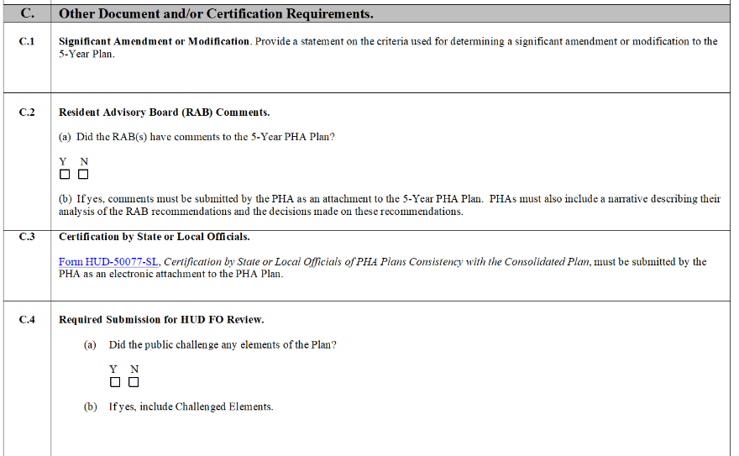
Form 50075-5Y – Section C

Slide 41
50075-5Y C.1: Significant Amendment or Modification
After submission of the 5-year plan, a PHA may amend or modify any policy, rule, regulation or other aspect of the plan. If determined to be a significant amendment or modification the following is required:
Plan must Include criteria for significant amendment/modification
HUD has afforded PHAs local discretion in defining the terms significant amendment or modification
Any significant amendment or modification is subject to the same requirements as the original PHA Plan (including time frames).
Requirements are to:
Consult the RAB
Be Consistent with the Consolidated Plan
Hold a Public 45-day Review
Obtain Board Approval in a Public Meeting.
Submit to HUD for Approval

Slide 42
50075-5Y C.1: Significant Amendment or Modification – Examples
Target population served shifts
Mission statement revisions
Strategic goals cannot be met due to circumstances that impact/prevent implementation of activities identified in PHA Plan
Changes to waiting list, admissions policies
Repositioning Actions

Slide 43
50075-5Y C.1: Significant Amendment - PHA Plan Example (NPHA)

Slide 44
50075-5Y C.2: Resident Advisory Board (RAB)
RAB comments:
Comments and recommendations must be considered and analyzed by the PHA
PHAs must submit as an attachment to the 5-Year PHA Plan any comments received from the RAB
PHAs must also include a narrative describing their analysis of the recommendations and the decisions made on these recommendations (see 24 CFR 903.13)
Approved Plan: PHAs may provide copies of the approved PHA Plan to each resident council and Resident Advisory Board

Slide 45
50075-5Y C.3: Certification by State or Local Official
Complete 50077-SL Form
Certification by State or Local Officials of PHA Plans Consistency with the Consolidated Plan
Certification must describe how the 5-Year PHA Plan is consistent with Consolidated Plan (Con. Plan)
Must be signed by State or Local Official (not PHA)
Must be submitted by the PHA as an electronic attachment to the PHA Plan

Slide 46
50075-5Y C.4: Required Submission for HUD Field Office (FO) Review
Challenged Elements
Elements of the PHA Plan that are challenged without resolution
Challenged element(s) must in included as an attachment to 5-Year PHA Plan:
A description of any challenges to the Plan elements
The source of the challenge
The PHA's response
This does not include items that residents or the PHA may have comments on outside of the PHA Plan process. Examples could include, but are not limited to funding, items the residents want at the PHA, etc.

Slide 47
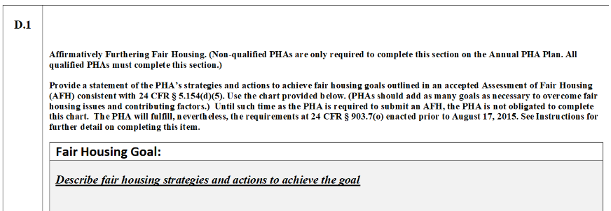
Form 50075-5Y D.1: Affirmatively Furthering Fair Housing

Slide 48
50075-5Y D.1: Affirmatively Furthering Fair Housing
Template instructions:
Until such time as the PHA is required to submit an AFH, the PHA will not have to complete section D
However, the PHA will address its obligation to affirmatively further fair housing in part by fulfilling the requirements at 24 CFR 903.7(o)(3) enacted prior to August 17, 2015:
Examine its own programs or proposed programs
Identify any impediments to fair housing choice within those programs
Addresses those impediments in a reasonable fashion in view of the resources available
Work with local jurisdictions to implement any of the jurisdiction’s initiatives to affirmatively further fair housing that require the PHA’s involvement
Maintain records reflecting these analyses and actions.

Slide 49
My Plan is done, now what?
The Plan template, certifications and supporting documents are emailed to the single point of contact at the local HUD field office.
HUD must review the Plan within 75 days
Otherwise, Plan is automatically approved.
24 CFR §903.23(c)(3)

Slide 50
What does HUD look for?
PHA Plans must meet the following three statutory standards, if not it will be disapproved:
Completeness: Does the PHA Plan contain all the information that is required to be included in the plan?
Consistency: Is the information provided as part of the PHA Plan consistent with the data on record at HUD?
Compliance: Is the information provided as part of the PHA Plan prohibited or inconsistent with QHWRA, the U.S. Housing Act of 1937 or any other applicable Federal law?
Is the Plan is consistent with any applicable Consolidated Plan for the jurisdiction in which the PHA is located?
24 CFR §903.23

Slide 51
PHA Plan Disapproval
If Plan does not comply with any of the three statutory standards:
Technical deficiencies
Substantive deficiencies
It may be disapproved:
In its entirety
Any part of the Plan
Any significant amendment or modification to the plan

Slide 52
Technical Deficiencies
No effect on information presented in the Plan to the RAB or public
PHA contacted to resubmit with corrections – following not required:
Consultation with the Resident Advisory Board (RAB),
Public hearing,
RAB assessment, and
45-day public comment/review period
Examples of technical deficiencies:
Mathematical errors

Slide 53
Substantive Deficiencies
Require consultation with the RAB
Require a new 45-day comment period and a public hearing
Substantive deficiencies affect the information presented to the RAB or to the public.
The PH Director will specify a reasonable time to resubmit plans to allow for corrections and the consultation process.

Slide 54
Substantive Deficiencies
Disapproval Examples:
PH did not meet with RAB – comments not included
A public hearing was not held
Inconsistent with the ConPlan
Violence Against Women Act (VAWA) information omitted
Repositioning plans not included
Consequences for Failure to Submit Approvable PHA Plans:
If a PHA fails to submit complete PHA Plans in a timely manner, HUD may impose sanctions including but not limited to the withholding of or future reductions in funding for the Capital Fund program, Operating Fund, or HCV administrative fees.

Slide 55
Q&A
If a PHA completes the wrong PHA Plan template, is it a Technical Deficiency or a Substantive Deficiency?
It is a Technical Deficiency if it does not have an effect on the information that was presented to the RAB or the public.

Slide 56
PHA Plan Approval
If Plan is complete (including all required certifications and supporting documents), consistent and compliant, PHA is notified in writing the Plan is approved.
PHA must make its approved Plan and the required attachments and supporting documents related to the Plan available for review and inspection at the principal office of the PHA during normal business hours.
To ensure RAB is fully engaged in the full plan process, PHAs may provide Plan approval letter and at least one copy of the approved plan to each RAB.
Each resident council may be provided a copy of the approved Plan.
PHAs are strongly encouraged to post the template submission and all plan elements on their website, if applicable.
September 13, 2023

Slide 57
Plan approval Process:
HUD reviews the Plan (within 75 days), notifies PHA of any problems
Plan is submitted to HUD via email
If complete, consistent and compliant, Plan approved
If technical deficiencies, PHA is notified to correct
Either PH director notifies PHA in writing or, if after 75 days no notice of disapproval, Plan considered approved
If Substantive deficiencies, Plan disapproved. PHA is notified of the specific reasons, the actions needed to meet the criteria and deadline for resubmission
PHA resubmits Plan

Slide 58
Wrap Up

Slide 59
Unique situations:
What should be in my plan if I want to designate units as undergoing modernization?
Qualified PHAs using Capital Funds for the modernization must provide documentation that the action was included in a Capital Fund submission for discussion at the annual public hearing required pursuant to 24 CFR 905.300. PIH Notice 2021-35.
Qualified PHAs not using Capital Funds for modernization projects must include this action in the 5-year PHA Plan
How do Qualified Agencies account for non-assisted over-income tenants at initial occupancy and police officer units through the PHA Plan process?
Terms and conditions are required to be in the 5-year agency plan (PIH Notice 2021-35).

Slide 60
Knowledge Check:
The 5-year Agency Plan is uploaded into EPIC? NO, it’s emailed to the PHA’s assigned portfolio management specialist
In lieu of submitting an annual plan in the “off years”, the form HUD 50077-CR is required? YES
When do I submit my plan? 75 days before the PHA’s FYB
Qualified PHAs aren’t required to have a RAB? False, there are no exceptions
The Plan is automatically disapproved if HUD doesn’t review it within 75 days? False, it is automatically approved
Holding the public hearing for the CFP and agency plan requirement at the same time is a best practice? Definitely!

Slide 61
Key Resources
Notice PIH 2015-18
https://www.hud.gov/sites/documents/PIH-2015-18.PDF
PHA Plans Website: https://www.hud.gov/program_offices/public_indian_housing/pha
HUD Agency Plan Regulations: https://www.ecfr.gov/current/title-24/part-903
PHA Plan Desk Guide (dated but helpful): https://www.hud.gov/sites/documents/DOC_8904.PDF
HUD Exchange RAB Resources: Public Housing Resident Toolkit: Guide 5: Resident Advisory Boards and the Housing Authority Plan Process - HUD Exchange

Slide 62
Miscellaneous
May be modifications/further guidance for Affirmatively Furthering Fair Housing (AFFH) Rule.
Plan templates could be updated. Even if expired, use the plans on HUD’s Forms website.
Do not Google the template and form numbers as the old forms may come up
Link to consolidated plans for metropolitan PHAs:
https://www.hudexchange.info/programs/consolidated-plan/

Slide 63
Thank You! Questions?

